Slide 1
COP3514 Program Design
Fall 2019
Instructor: Dr. Jing Wang

Slide 2
A bit about me
Instructor II at USF
Ph.D. in the Dept. of EE and CS at Vanderbilt University
Research and teaching interest: Computer animation and game development

Slide 3
Communications
Instructor and TA: Email and office hours
TA and Instructor’s Email Response time: within 24 hours on weekdays, within 48 hours on weekends
Discussion board on Canvas (Please do not post your code on Discussion board)
If you have a file attachment, send it from your USF email account, do NOT use canvas email

Slide 4
Syllabus

Slide 5
Prerequisite
Programming Concepts (COP2510) or equivalent
Variables and expressions
Conditional statement (if/else, switch)
Loops (while, do-while, for)
Arrays
Basic understanding of method (function)
How many of you took Programming Concepts in Java? Other languages?

Slide 6
Material for Improving Preparedness
Video tutorials:
C Programming Tutorials, thenewboston: https://www.youtube.com/watch?v=2NWeucMKrLI&list=PL6gx4Cwl9DGAKIXv8Yr6nhGJ9Vlcjyymq
Tutorials: 12 through 31
Exercises:
Textbook (Ch. 2) PP#8, (Ch. 4) PP #1, (Ch. 5) PP #7, (Ch. 6) PP #1, #8
PP: Programming Projects

Slide 7
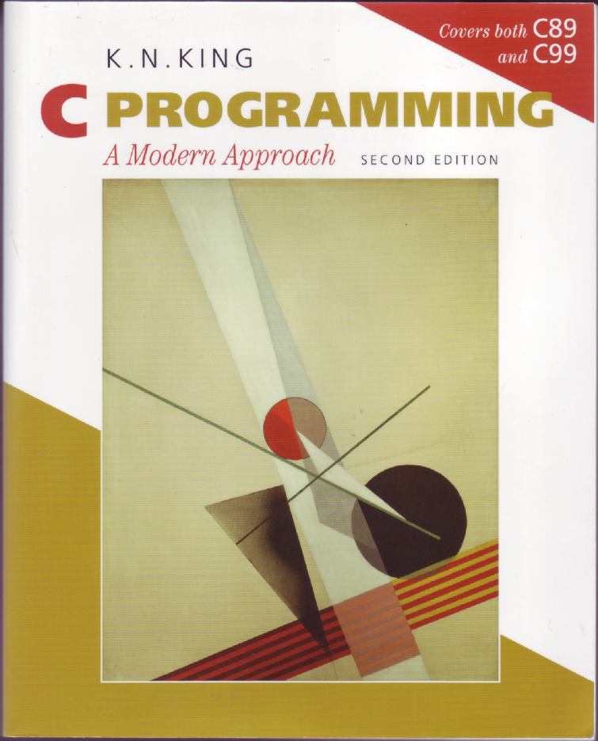
Textbook
C Programming, A Modern Introduction Second Edition
K.N. King
W.W. Norton & Company, 2008
ISBN 978-0-393-97950-3 (pbk.)
Textbook's Web Site:
http://www.knking.com/books/c2/
Errata
Solutions to some Exercises

Slide 8
Using the Textbook’s Website
http://www.knking.com/books/c2/
Solutions to one-third of the exercises and programing projects available
Exercises and projects for which answers are provided are marked with a icon in the book

Slide 9
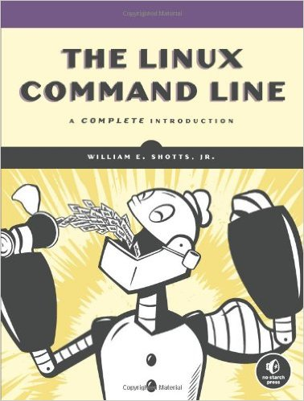
Textbook
The Linux Command Line: A Complete Introduction by William E. Shotts, Jr.
Access the ebook on USF library’s website.

Slide 10
Highlights of Course Objectives
Compile, test, and debug C programs in a Unix environment.
Write programs of moderate size and complexity in the C programming language: functions, strings
Use pointers correctly as function parameters and data structure elements.
Use dynamic memory allocation correctly and appropriately: Linked list

Slide 11
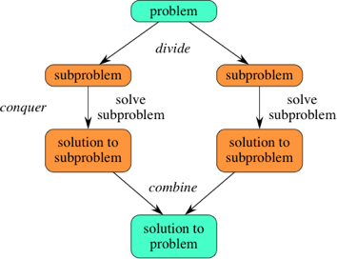
Learning Objectives
Problem solving
Complex task & abstract thinking
Divide & conquer
Paying attention to details
Logic & reasoning

Slide 12
Policies on Projects
It is OK to discuss ideas and concepts for the projects with others. BUT:
Don’t let anyone see or copy your program.
Don’t look at or copy anyone else’s program.
Don’t copy from the internet or any other source.
Write your own code
Copying someone else's work or from the internet will result in a failing grade in the course.
Students who knowingly give their codes to someone else will be penalized equally.

Slide 13
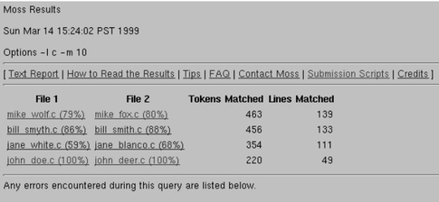
Policies on Projects
We will check for plagiarism.
Moss (A System for Detecting Software Plagiarism)
http://theory.stanford.edu/~aiken/moss/

Slide 14
Materials on Canvas
Canvas>Announcements
Announcements of events, updates on material or assignments, office hours changes
Canvas> Files
Syllabus
Weekly Folder
Outline of weekly topics, homework exercises
Lecture slides
Example programs
Project description and requirement
Practice tests and answer keys
Canvas> Assignments
Project description and submission

Slide 15
Practice, Practice, Practice
Assignments and Exercises
Practice (In-class) exercises
Homework exercises is important for preparing for the exams! (posted in topics and assignment document in the Files section>Weekly folder on Canvas)
Projects (completing the practice exercises before doing projects will save you time)

Slide 16
Practice (In-class) Exercises
Lecture (35-45 minutes) + In-class exercises
You can work on the in-class exercises on your own or in a small group
Bring your laptop to all future classes (except review sessions)
TA and I will be walking around to provide help
If you would like me or the TA to walk you through the exercise step-by-step, please feel free to ask
If you can not finish the exercise during the class time, make sure you finish it at home before the next class

Slide 17
Getting Started

Slide 18
Getting Started
We will compile, test, and debug C programs on a networked Linux/Unix system.
Must have access to Research Computing student cluster system
http://www.rc.usf.edu/
A cluster computer hosted by Research Computing (RC) at USF
6200 processors running Red Hat Enterprise Linux 6
Contact: rc-help@usf.edu
hostname: sc.rc.usf.edu

Slide 19
Unix Account on Student Cluster
If you registered before Thursday 8/22, 7:43am, I have sent your netID to research computing and you should have access to your account.
If you registered after Thursday 8/22, 7:43am and you can not access the cluster, send an email to: rc-help@usf.edu
In the email with title “Request account on student cluster”, please include:
Your name and netID, instructor’s name (Dr. Jing Wang), and course name &ID (Program Design, COP3514, Your section number)

Slide 20
Install Terminal Emulator
For Windows OS, you could choose to use any of the following terminal emulators
MobaXterm (terminal and file transfer): Recommended
http://mobaxterm.mobatek.net/
Install the free home edition
Putty (terminal) and WinSCP (file transfer)
http://www.chiark.greenend.org.uk/~sgtatham/putty/download.html
https://winscp.net/eng/download.php

Slide 21
Connection
MobaXterm
Choose Session, it then opens up a Session Setting window
Choose SSH
Type in hostname and your username, then click OK
Hostname: sc.rc.usf.edu
Putty and WinSCP
Putty: Type in hostname and click Open
WinSCP: Type in hostname, username, and password, then click Login
Hostname: sc.rc.usf.edu

Slide 22
Mac Users
For MAC users, you don’t need to install any emulator. MAC OS X includes Secure Shell terminal.
Open Terminal in Applications>Utilities. Then choose the menu Shell>New Remote Connection. Select Secure Shell in the Service section, then click the + button under the Server section. Type in the host name: sc.rc.usf.edu , then put your username in the User field.

Slide 23
Mac Users
In the textfield on the bottom, it should show: ssh yourusername@sc.rc.usf.edu. Click connect.
For file transfer, use sftp instead of ssh in the service section and connect to circe (for sftp commands: http://www.tecmint.com/sftp-command-examples/ ).
If you prefer graphical interface for file transfers, download FileZilla (https://filezilla-project.org/ )

Slide 24
Today’s Topics
Introduction to Unix
Chapter 1: Introducing C
Chapter 2: C Fundamentals

Slide 25
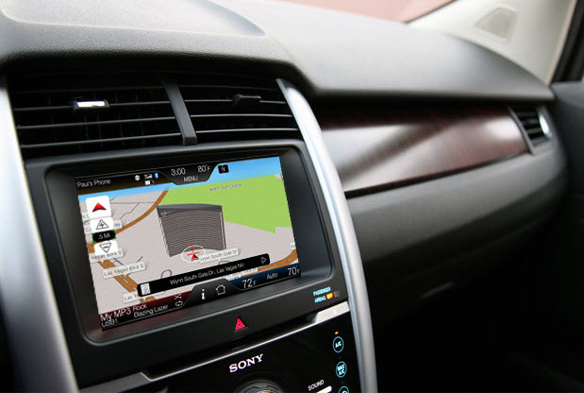

Why Unix/Linux?
Unix/Linux is everywhere
Mac OS: Unix-based graphical interface OS
Embedded systems in cars, appliances, and devices
Super computers
Mobile phones
The Cloud
Big data

Slide 26
Unix
Unix is an operating system.
An entire family of operating systems such as Linux and BSD (Berkeley Software Distribution).
All versions of Unix are multiuser, multitasking, and can use the same commands
The major components of Unix are the kernel and the command shell.
Kernel: a set of functions that constitute the guts of the operating systems.
Command shell: interpret commands into the proper system action.

Slide 27
Shell
The most common shells are Bourne Shell (sh) and Bourne Again Shell (bash)
To find out what shell you are using, on the terminal, type:
echo $SHELL

Slide 28
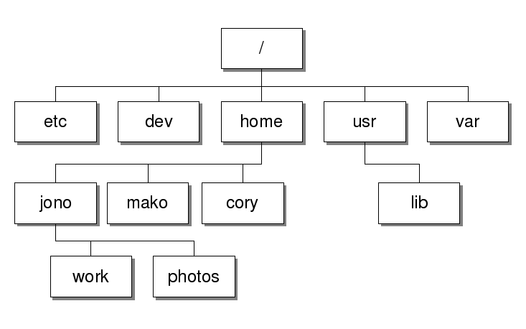
The Unix File System
root
An example Unix file system

Slide 29
The Directories
/
root
.
the current directory
..
the parent directory
~
your home directory
When your first login, your current working directory is your home directory

Slide 30
Text (Program) Editor
nano (recommended)
Text based
Commands listed at the bottom of the editor
emacs
Graphical interface
vi or vim
We will start to use vi in a few weeks

Slide 31
Chapter 1
Introducing C
31

Slide 32
Origins of C
C is a by-product of UNIX, developed at Bell Laboratories by Ken Thompson, Dennis Ritchie, and others.
Thompson designed a small language named B, a systems programming language developed in the mid-1960s.
By 1971, Ritchie began to develop an extended version of B.
32

Slide 33
Origins of C
As the language began to diverge more from B, Ritchie changed its name to C.
The language was stable enough by 1973 that UNIX could be rewritten in C.

Slide 34
Versions of C
K & R – Kernighan and Ritchie
The C Programming Language
First Edition, 1978
ANSI/ISO Standard – C89
ANSI: American National Standards Institute
ISO: International Organization for Standardization
C89 is widely used
C89 with some extensions is default for our C compiler gcc on the student cluster
"New" ANSI/ISO Standard – C99
Differences marked in our textbook

Slide 35
C-Based Languages
C++ includes all the features of C, but adds classes and other features to support object-oriented programming.
Objective-C is superset of C with Object-oriented capabilities
It is the main programming language used by Apple for the OS X and iOS operating systems
Java is based on C++ and therefore inherits many C features.
C# is a more recent language derived from C++ and Java.
Perl has adopted many of the features of C.
35

Slide 36
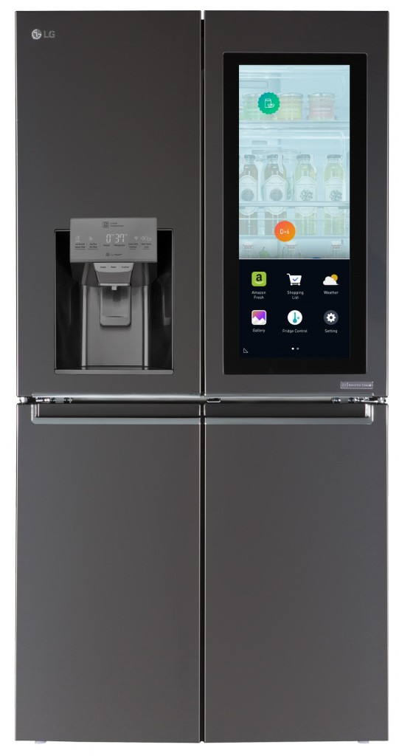
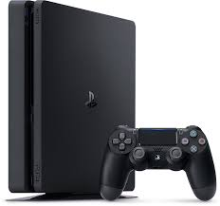
Why C?
C provides access to machine-level concepts (bytes and pointers, for example) that other languages try to hide: knowing how things work
C is used for applications of all kind
Operating systems
Embedded systems
Commercial data processing
Database engines development
Program Compilers and Programming language interpreters
Game development

Slide 37
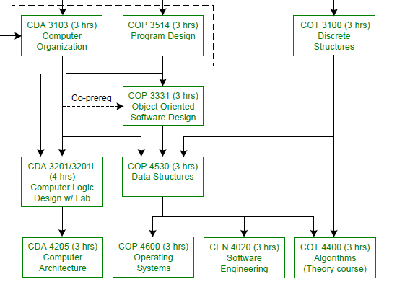
Future Courses
Electives that requires C/C++ programming: Computer Networks, Computational Geometry, Cybersecurity, Image Processing, Computer Graphics, and others.

Slide 38
Chapter 2
C Fundamentals

Slide 39
Objectives
Write a small program to implement a simple algorithm.
Edit, compile, and test your program on a networked Unix system.

Slide 40
Program: Printing Hello World
#include <stdio.h>
int main(void)
{
printf("Hello World!\n");
return 0;
}
This program might be stored in a file named helloWorld.c.
The file name doesn’t matter, but the .c extension is often required.

Slide 41
The General Form of a Simple Program
Simple C programs have the form
directives
int main(void)
{
statements
}
41

Slide 42
Compiling and Linking
Before a program can be executed, three steps are usually necessary:
Preprocessing. The preprocessor obeys commands that begin with # (known as directives)
Compiling. A compiler then translates the program into machine instructions (object code).
Linking. A linker combines the object code produced by the compiler with any additional code needed to yield a complete executable program.

Slide 43
The GCC Compiler
GCC (GNU Compiler Collection) is one of the most popular C compilers.
GCC is supplied with Linux but is available for many other platforms as well.
Using this compiler to compile pun.c:
gcc helloWorld.c

Slide 44
Compiling and Linking Using cc
After compiling and linking the program, gcc leaves the executable program in a file named a.out by default.
Run:
./a.out
The -o option lets us choose the name of the file containing the executable program. To name the executable version of helloWorld.c to :
gcc -o hello helloWorld.c
Run:
./hello

Slide 45
Directives
Before a C program is compiled, it is first edited by a preprocessor. Commands intended for the preprocessor are called directives.
Directives always begin with a # character.
By default, directives are one line long; there’s no semicolon or other special marker at the end.
Example:
#include <stdio.h>
<stdio.h> is a header containing information about C’s standard I/O library.

Slide 46
The main Function
The main function is mandatory.
main is special: it gets called automatically when the program is executed.
main returns a status code; the value 0 indicates normal program termination.
If there’s no return statement at the end of the main function, many compilers will produce a warning message:
warning: control reaches end of non-void function

Slide 47
Statements: Printing Strings
When the printf function displays a string literal—characters enclosed in double quotation marks—it doesn’t show the quotation marks.
printf doesn’t automatically advance to the next output line when it finishes printing.
To make printf advance one line, include \n (the new-line character) in the string to be printed.

Slide 48
Comments
A block comment begins with /* and end with */
/* This is a comment */
Block comments may extend over more than one line
/* Name: pun.c
Purpose: Prints a bad pun.
Author: K. N. King */
Line comments ends automatically at the end of a line
// This is a comment
Line comments are safer
No chance that an unterminated comment will accidentally consume part of a program.

Slide 49
Before Next Class
Install MobaXterm or (Putty and WinSCP) if you have Window OS and login to the student cluster
Host name: sc.rc.usf.edu
Login with your netid and password
Mac users if you prefer graphical interface for file transfers, download FileZilla (https://filezilla-project.org/ )

Slide 50
Code::Blocks
Install Code::Blocks as a backup IDE
http://www.codeblocks.org/downloads/26
Windows: download codeblocks-17.12mingw-setup.exe
Verify the Compiler's Path:
Goto "Settings" menu ⇒ "Compiler..." ⇒ In "Selected Compiler",
Choose "GNU GCC Compiler" ⇒ Select tab "Toolchain Executables" ⇒ Check the "Compiler's Installation Directory".
It shall be set to the "MinGW" sub-directory of the CodeBlocks installation directory,
For example, suppose that CodeBlocks is installed in "c:\Program Files\codeblocks",
Set it to "c:\Program Files\codeblocks\MinGW".

Slide 51
Code::Blocks
After installed, Choose File>New>File …
Choose C/C++ source, choose C and name the program and choose the location
Copy this program to Code::Block to test it
#include <stdio.h>
int main()
{ printf("Hello World!");
return 0;
}
Choose Build>Build, if the program is built successfully, choose Build>Run and the terminal should display Hello World!

Slide 52
Before Next Class
Bring your laptop to all future classes (except review sessions)
Make sure laptop battery is charged
In-class exercises: on your laptop

Slide 53
First Day Attendance

